Slide 1
ANGULAR
BY TELYACHY VADYM

Slide 2

WHAT IS ANGULAR?
AngularJS used to be the “golden child” among JavaScript frameworks, as it was initially introduced by Google corporation in 2012. It was built with the Model-View-Controller concept.
The framework, written in pure JavaScript, was intended to decouple an application’s logic from DOM manipulation, and aimed at dynamic page updates.
Specifically, an interesting concept of data binding was introduced that meant automatic updates of the view whenever the model (data) changed, and vice versa. On top of that, the idea of directives was presented, which allowed inventing your own HTML tags, brought to life by JavaScript.

Slide 3
WHY TO USE ANGULAR?
The benefits of Angular include −
Angular presents you not only the tools but also design patterns to build your project in a maintainable way. When an Angular application is crafted properly, you don’t end up with a tangle of classes and methods that are hard to modify and even harder to test. The code is structured conveniently and you won’t need to spend much time in order to understand what is going on.
It’s JavaScript, but better. Angular is built with TypeScript, which in turn relies on JS ES6. You don’t need to learn a totally new language, but you still receive features like static typing, interfaces, classes, namespaces, decorators etc.
No need to reinvent the bicycle. With Angular, you already have lots of tools to start crafting the application right away. You have directives to give HTML elements dynamic behavior. You can power up the forms using FormControl and introduce various validation rules. You may easily send asynchronous HTTP requests of various types. You can set up routing with little hassle. And there are many more goodies that Angular can offer us!

Slide 4
WHY TO USE ANGULAR?
Components are decoupled. Angular strived to remove tight coupling between various components of the application. Injection happens in NodeJS-style and you may replace various components with ease.
All DOM manipulation happens where it should happen. With Angular, you don’t tightly couple presentation and the application’s logic making your markup much cleaner and simpler.
Testing is at the heart. Angular is meant to be thoroughly tested and it supports both unit and end-to-end testing with tools like Jasmine and Protractor.
Angular is mobile and desktop-ready, meaning you have one framework for multiple platforms.
Angular is actively maintained and has a large community and ecosystem. You can find lots of materials on this framework as well as many useful third-party tools.
So, we can say that Angular is not just a framework, but rather a platform that empowers developers to build applications for the web, mobile, and the desktop

Slide 5
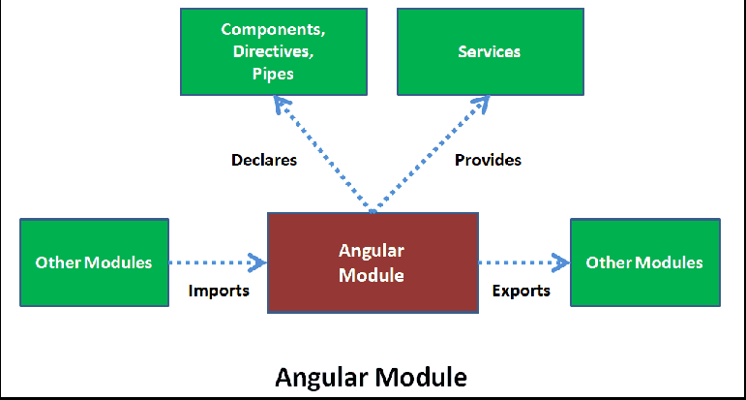
MODULES
Angular NgModules differ from and complement JavaScript (ES2015) modules. An NgModule declares a compilation context for a set of components that is dedicated to an application domain, a workflow, or a closely related set of capabilities. An NgModule can associate its components with related code, such as services, to form functional units.
Every Angular app has a root module, conventionally named AppModule, which provides the bootstrap mechanism that launches the application. An app typically contains many functional modules.
Organizing your code into distinct functional modules helps in managing development of complex applications, and in designing for reusability. In addition, this technique lets you take advantage of lazy-loading—that is, loading modules on demand—to minimize the amount of code that needs to be loaded at startup.

Slide 6
COMPONENTS
Every Angular application has at least one component, the root component that connects a component hierarchy with the page document object model (DOM). Each component defines a class that contains application data and logic, and is associated with an HTML template that defines a view to be displayed in a target environment.
The @Component() decorator identifies the class immediately below it as a component, and provides the template and related component-specific metadata.
Templates, directives, and data binding
A template combines HTML with Angular markup that can modify HTML elements before they are displayed. Template directives provide program logic, and binding markup connects your application data and the DOM. There are two types of data binding:
Event binding lets your app respond to user input in the target environment by updating your application data.
Property binding lets you interpolate values that are computed from your application data into the HTML.
Before a view is displayed, Angular evaluates the directives and resolves the binding syntax in the template to modify the HTML elements and the DOM, according to your program data and logic. Angular supports two-way data binding, meaning that changes in the DOM, such as user choices, are also reflected in your program data.

Slide 7
SERVICES AND DEPENDENCY INJECTION
For data or logic that isn't associated with a specific view, and that you want to share across components, you create a service class. A service class definition is immediately preceded by the @Injectable() decorator. The decorator provides the metadata that allows other providers to be injected as dependencies into your class.
Dependency injection (DI) lets you keep your component classes lean and efficient. They don't fetch data from the server, validate user input, or log directly to the console; they delegate such tasks to services.
Routing
The Angular Router NgModule provides a service that lets you define a navigation path among the different application states and view hierarchies in your app. It is modeled on the familiar browser navigation conventions:
Enter a URL in the address bar and the browser navigates to a corresponding page.
Click links on the page and the browser navigates to a new page.
Click the browser's back and forward buttons and the browser navigates backward and forward through the history of pages you've seen.

Slide 8
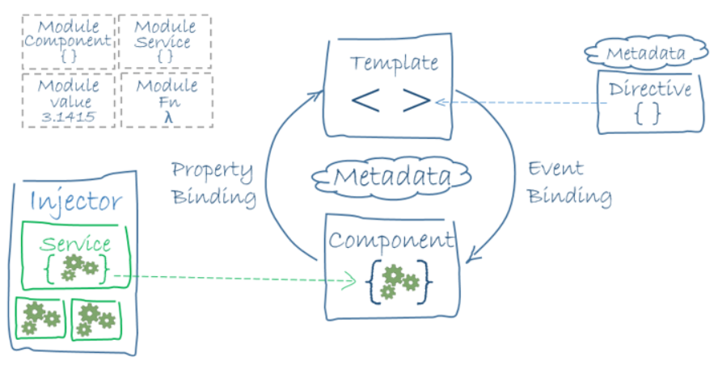
CONCLUSION
You've learned the basics about the main building blocks of an Angular application. The following diagram shows how these basic pieces are related.
Together, a component and template define an Angular view.
- A decorator on a component class adds the metadata, including a pointer to the associated template.
- Directives and binding markup in a component's template modify views based on program data and logic.
- The dependency injector provides services to a component, such as the router service that lets you define navigation among views.

Slide 9
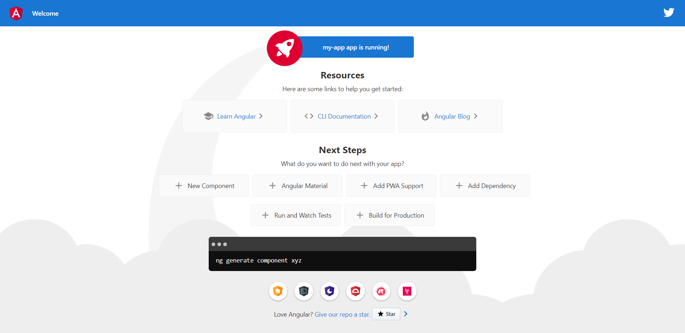
ENVIROMENT SETUP
To start using Angular do several steps:
-Install Angular CLI globally: npm install -g @angular/cli
-Create new project: ng new my-app (select all defaults)
-Run app: cd my-app ng serve –open (by default it will be on 4200 port)

Slide 10
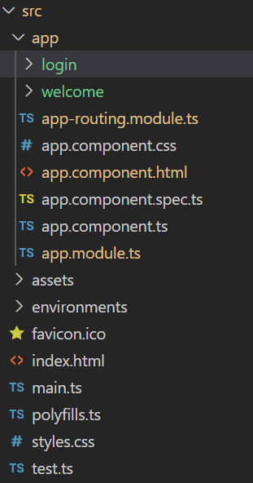
SOME ACTION
So, we created Angular APP and we have some files here.
app.module.ts – contains configuration of our app
app-routing.module.ts – contains URL mapping of our components, routes, that are used to acess components
app.component.ts – our root component
index.html – our first page of app
login,welcome – our sub components, I will talk about them later

Slide 11
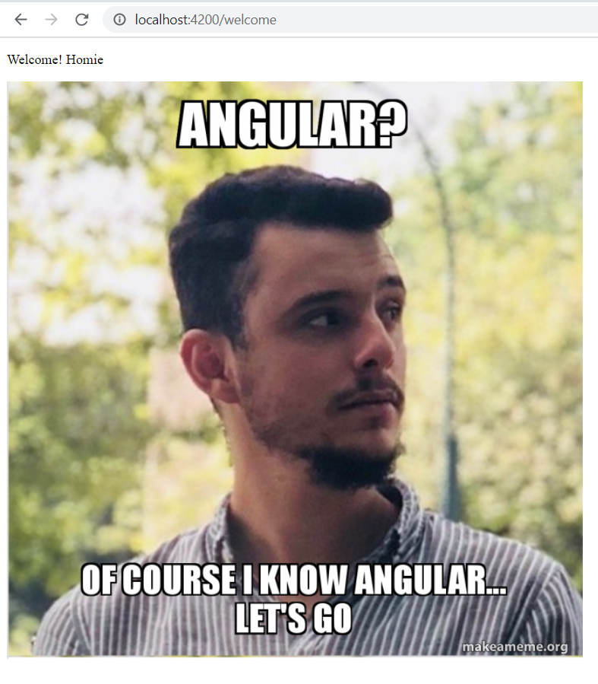
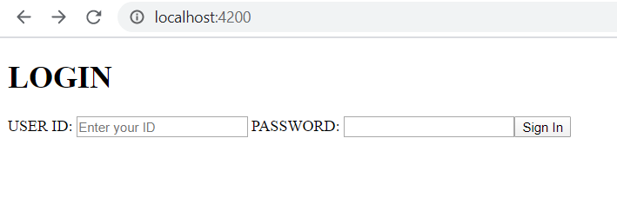

WHAT I HAVE DONE
I will create Angular app with login page and welcome page, using 2 sub-components. Our final view will be like that:

Slide 12
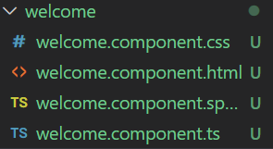
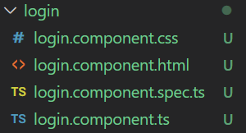
CREATING COMPONENTS
To start with we need to create components, because every Angular app consists of them.
We have 4 files here: .css, .html, .spec.ts, .ts.
CSS – file with styles for our component
HTML – contain our html-code for component(like JSX in React)
Spec.ts – our component’s configuration etc.
Ts – our main components code, we will write here
ng g c Login
ng g c Welcome

Slide 13
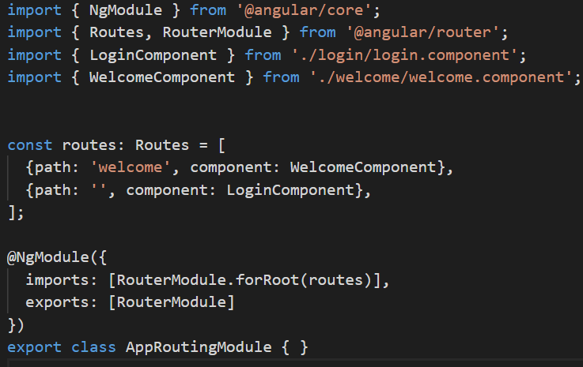
ADDING ROUTES
In order to access pages lets add some routes in app-routing.module.ts
I reinitialized home page with LoginComponent and added new route to /welcome, where we have our WelcomeComponent

Slide 14
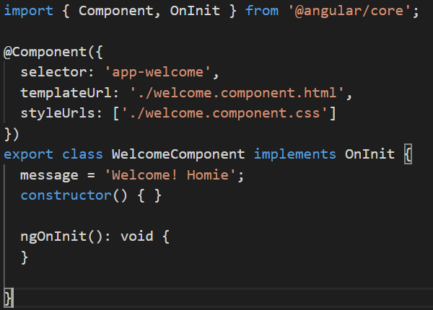

VALUES
In Angular we can initialize some values and use them in our html-code. There is two-way binding, so we can change code by our outer part, and change outer part by our code.
Let’s initialize some value and add some HTML to our Welcome page
welcome.component.ts
welcome.component.html

Slide 15
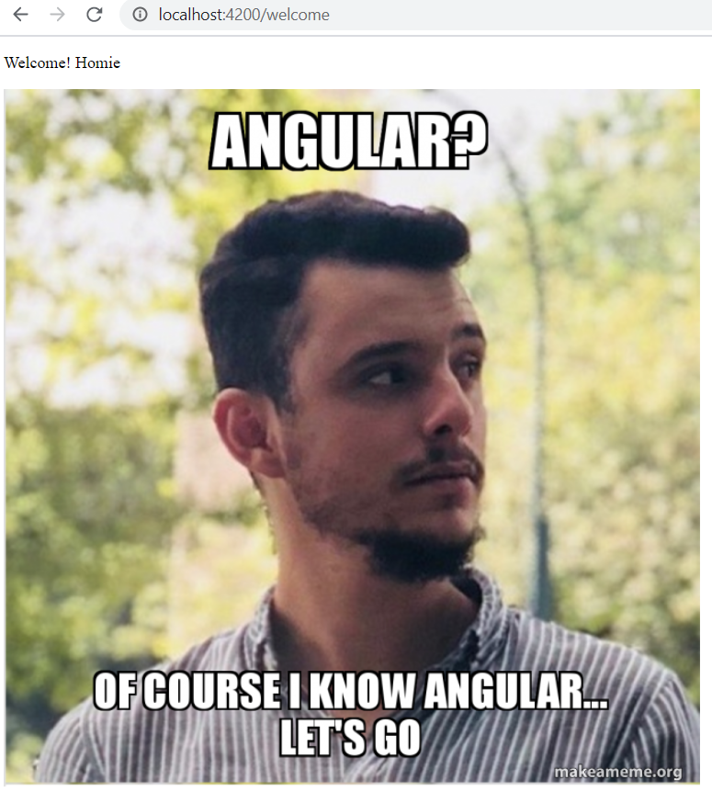
ADDING ROUTES
Now our page looks loke this:
We can go to this page by writing /welcome URL. NOTE: By default our app running on 4200 port, but you can change it (ng serve --port 4201, or in angular-cli.json file)

Slide 16
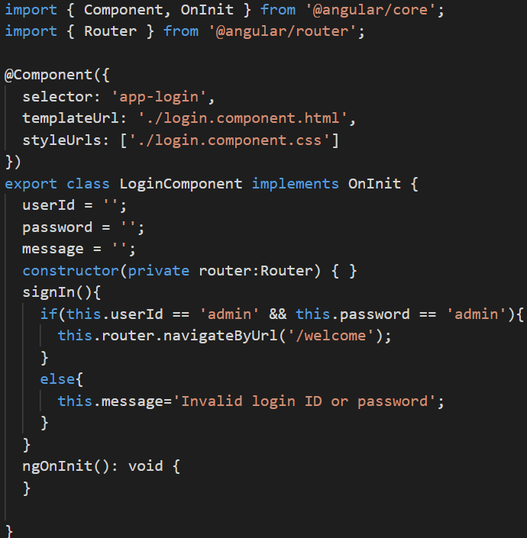
LOGIN
Lets change some login page:
Router is injected
Navigate to welcome page:

Slide 17
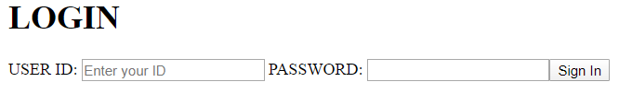
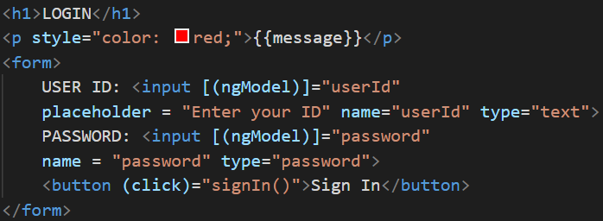
LOGIN HTML
Now our page looks loke this:
Directive [(ngModel)] used to two-way binding with attributes userId and password from class LoginComponente
Directive click is used to bind signIn() to on-click event
ngModel is imported from FormsModule
login.component.html

Slide 18
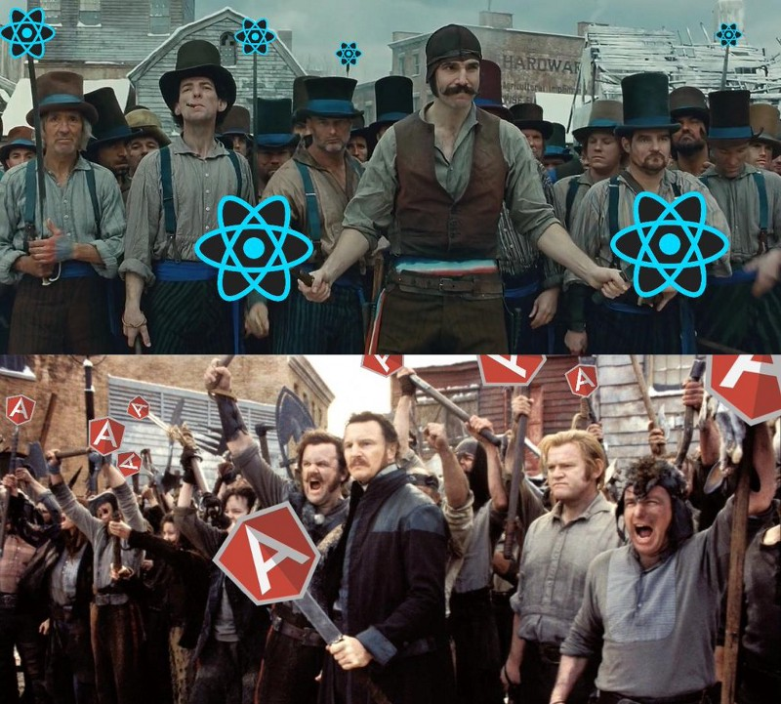

The last was done
By Vadym Teliachiy

